Slide 1
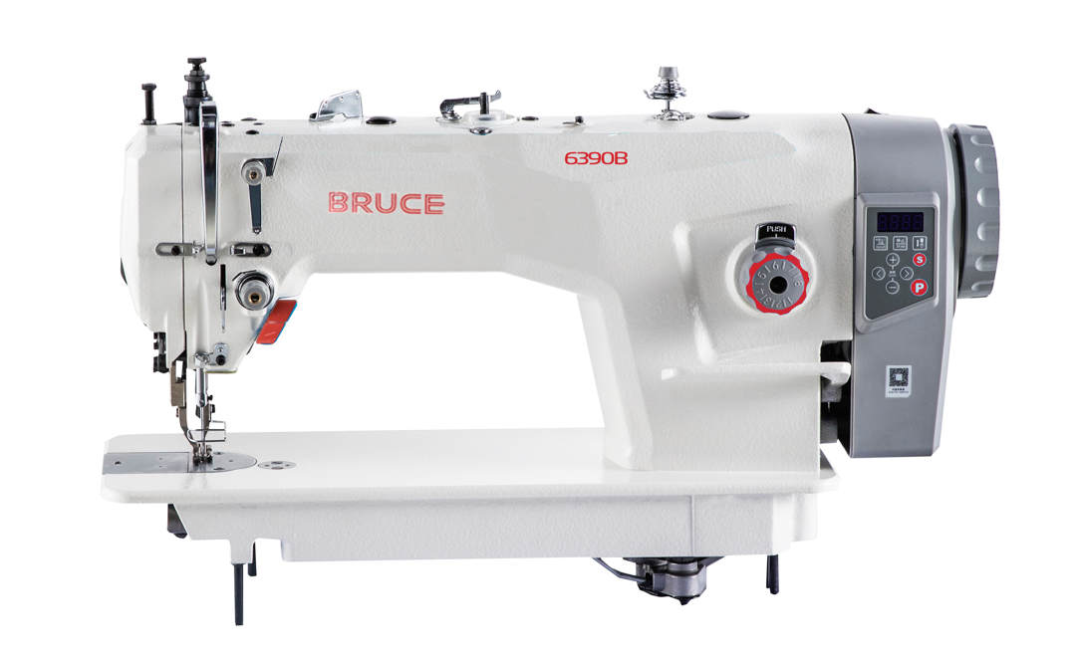
BRC-6390B Power saving Direct drive Top and BOTTOM FEEDING Machine
2023.3

Slide 2
Content
1.Naming rules
2.Product description
3.Product selling point

Slide 3
1.Naming rules
Feature Recognition ：
6390B
-
CZ
6390 series feature recognition
C | First generation | Z | Zobow Control Box
Z | Chinese Hook | -12 | 12mm needle length
From left to right：-A-CZ-12
Model | First generation | Feature Recognition
Main Model ：
Machine type | Main Model
Direct drive top and bottom feeding machine | 6390B

Slide 4
二、产品概要
BRC-6390B Direct drive top and bottom feeding machine, it not only incorporates proprietary service genes such as one shaft transmission and one-key restore , but also has Strong for thick and seal design ,added the functions of visual alternating quantity adjustment and stop key , which improves the convenience and safety of the machine.
Basic Parameters
Max Sewing Speed | 2200rpm
Factory sewing speed | 2000rpm
Motor Power | 750W
Needle gauge | 1-8mm（12mm is optional）
Press footer height | 7.5mm by hand/16mm by knee
Needle Type | DPx17 #23
Thread take-up stroke | 71mm
Needle bar stroke | 37mm
Volume | 720×280×570mm
Weight | 35/42kg

Slide 5
2.Product description-detail technical parameters
Model | Application | Needle | Thread no. | Needle gauge （mm） | Press Footer Height (mm) | Max Speed （S.p.m） | Volume （mm） | Weight （kg）
BRC-6390B-A-CZ | normal material | DPx17 20-23# | 2 | 8 | 7-16 | 2200 | 720×280×570 | 35/42
BRC-6390B-A-CZ-12 | 12mm needle length | DPx17 22# | 2 | 12 | 7-16 | 2200 | 720×280×570 | 35/42

Slide 6
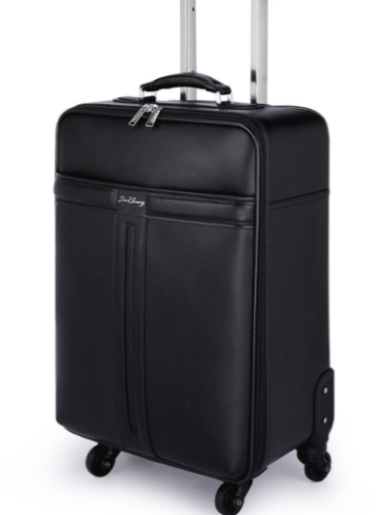
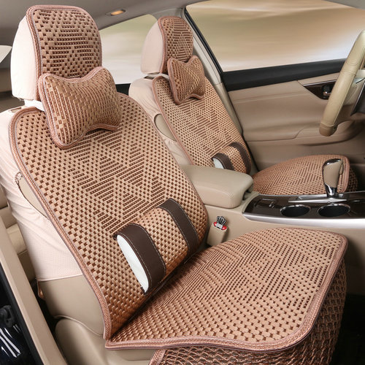
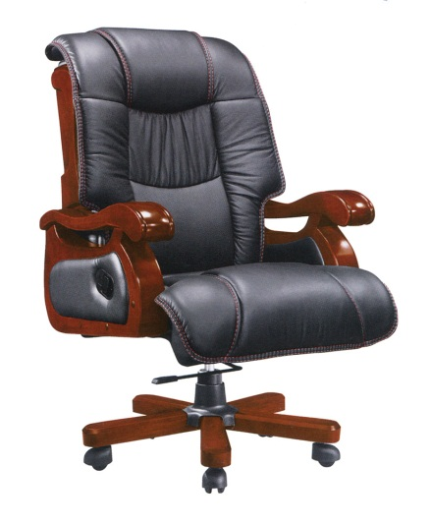
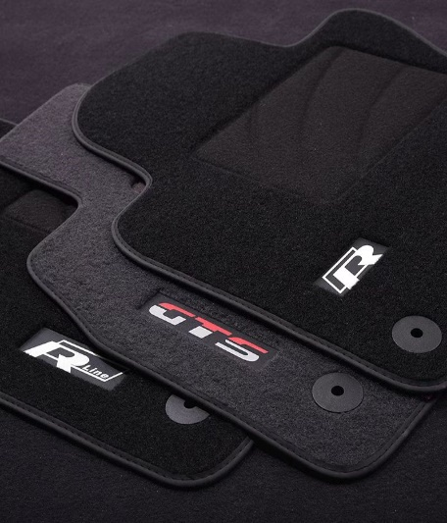
2.Product description-Applicable sewing products
Suitable for sewing products such as seat cushions, bags, swivel chairs, floor mats,
home textiles, hats, etc.
Suitable for sewing: leather, canvas, denim, non-woven fabrics, etc.
Bag
Seat cushion
Swivel chair
Floor mat

Slide 7
3.Product selling point
No. | Classification | Selling points | Features | Advantages
1 | Stable and reliable | Strong for thick, energy saving and high efficiency | 750w power motor | Top and bottom synchronous feeding, super strong feeding ability, while sewing 10 layers of leather also achieve beautiful stitches. The control system of motor and electric control is optimized and improved, and the puncture force is increased by 36%.
 |  | Seal design, no oil and no worry | Sealed presser foot lifting shaft, solid grease lubrication | The sealed presser foot lifting shaft is lubricated by imported solid grease to avoid oil greasy troubles.
 |  | Single shaft drive , stable and fast | Single shaft drive | Reduce the torque of the whole machine, stable operation, light sewing, more durable, lower noise and vibration
 |  | Alternating quantity visualization , accurate adjustment | Visual adjustment of alternating quantity. | The scale mark is added to the crank. The operator can adjust the alternating quantity gear according to the thickness of the sewing products, making the adjustment more convenient and accurate.
2 | Convenient operation | Simple panel, easy to learn and use | One key to reset，New stop key | New stop key: After pressing the stop key, the machine will stop running, eliminating potential safety hazards caused by incorrect operation when power is on.
 |  | Integrated design , simple and easy for use | Integrated design | Electromechanical integration, stable and reliable, plug and play, convenient and convenient.
3 | Improved performance | Improved performance, more reliable | Improved performance | Noise, torque, vibration and other all-round quality objectives are further optimized to ensure reliable quality and improve the operator’s sense of experience.

Slide 8
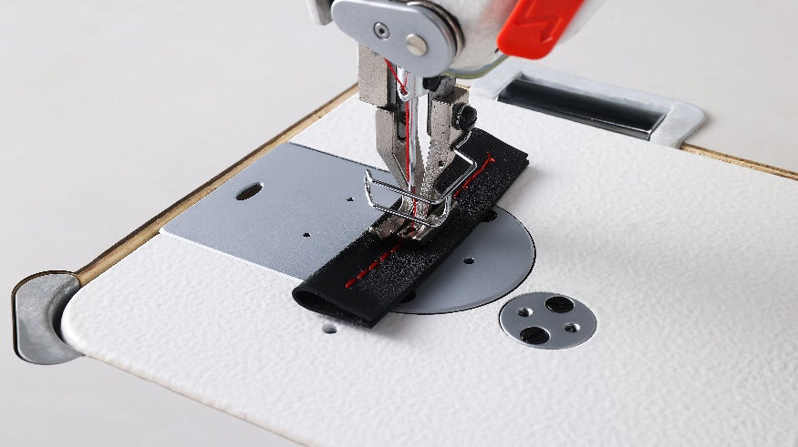
3.Stable and reliable - Strong for thick, energy saving and high efficiency （1/4）
Top and bottom synchronous feeding, 750w power motor, super strong feeding ability, while sewing 10 layers of leather also achieve beautiful stitches.
The control system of motor and electric control is optimized and improved, and the puncture force is increased by 36%.

Slide 9
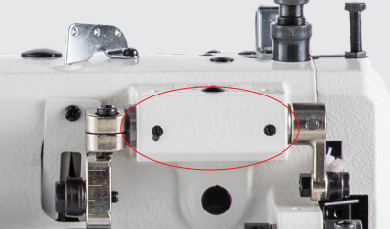
3.Stable and reliable - Sealed design, no oil and no worry（2/4）
The sealed presser foot lifting shaft is lubricated by the imported solid grease to avoid oil troubles. The bushing adopts a copper sleeve design with high wear resistance to improve wear resistance and prolong service life.

Slide 10
3.Stable and reliable - Single shaft drive , stable and fast
（3/4）
Reduce the torque of the whole machine, stable operation, light sewing, more durable, lower noise and vibration

Slide 11
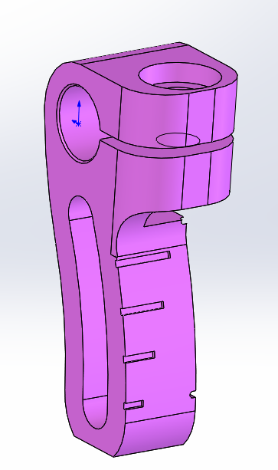
3.Stable and reliable - Alternating quantity visualization , accurate adjustment （4/4）
NEW
Visual adjustment of alternating quantity. The scale mark is added to the crank. Operators can adjust the alternating quantity gear according to the thickness of the sewing products, making the adjustment more convenient and accurate.
Alternating quantity Gear | Thickness of sewn products
5 | 6-8mm
4 | 4-6mm
3 | 2-4mm
2 | 0-2mm

Slide 12
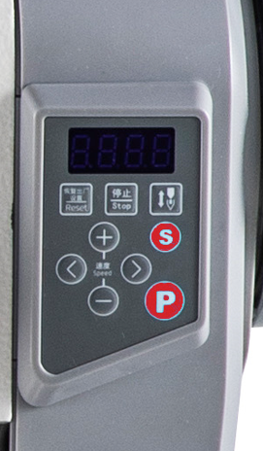
3. Convenient operation - Simple panel, easy to learn and use （1/3）
NEW
New stop key: when press the stop key, the machine will stop running, eliminating potential safety hazards caused by incorrect operation when power is on.
(No response when stepping on the pedal after opening, which can be used for live replacement of needle position components and local debugging)
One key to reset: Users can reset the parameter to self-set option and factory option depends on their own requirements，easy to operate，no longer worry about mis-operation.
Stop key
Up and down needle position
Reset key

Slide 13
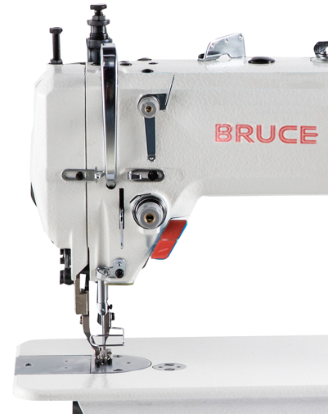
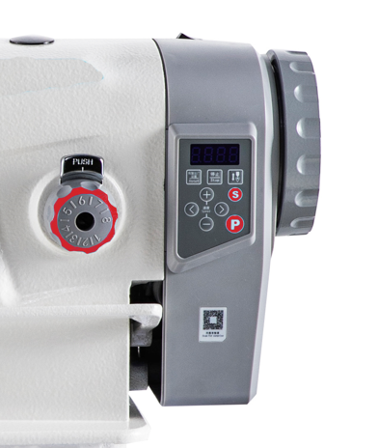
3. Convenient operation - Integrated design，simple and easy for use （2/3）
Electric control integration design: electromechanical integration, stable and reliable, plug and play, convenient and convenient , energy saving is up to 70%.
Half stitch key：realize the function of half stitch by pressing the key；
LED light: Multi-position brightness adjustment, no dead Angle lighting, convenient operation, stable performance, beautiful and practical.
LED light adjust
Half stitch key

Slide 14
3. Improved performance – Improved performance, more reliable（1/1）
Noise, torque, vibration and other all-round quality objectives are further optimized to ensure reliable quality and improve the operator's sense of experience.
Noise reduced by 2 dB
Torque reduced by 0.1N. m
Vibration reduced by 80um
Notes:
噪音降低2分贝，力矩提升0.1N.m，振动降低80um。

Slide 15
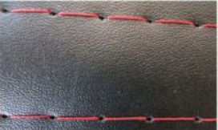
4.Optional model: BRC-6390B-A-CZ-12
It is suitable for sewing with large stitch length, such as curtains, carpets, home textiles, slippers, etc.

